Slide 1


Policy as Code: Automating Compliance with Data Mesh
Shawn C. Kyzer, Associate Director, Data Engineering, AstraZeneca

Slide 2







Who am I?
Shawn Kyzer, Associate Director Data Engineering, AstraZeneca.
My partner, our two adorable pups, and I traded Washington, D.C. for beautiful Barcelona five years ago. When I'm not tinkering with some kind of code or tech, you'll find me exploring new corners of the world 🌎, speaking at some conference🎤, hitting the running trails 🏃‍♂️, or indulging in some serious culinary delights 🍽️.

Slide 3


Agenda
01
02
03
04
05
Challenges with Data Governance Policy Implemenation
Policy as Code
Practical Use Cases
AI Oversight
Data Mesh

Slide 4




Increasingly complex data landscapes with diverse data types and sources.
The Challenges of Data Governance and Compliance
The proliferation of decentralized data ownership models like data mesh.
The changing regulatory environment includes GDPR and other industry-specific regulations.
The high cost of non-compliance (fines, reputational damage).
Need for agility to adapt to changing business needs and requirements.

Slide 5

DISCONNECT BETWEEN POLICY CREATION, ENFORCEMENT AND IMPLEMENTATION
Are you tired of asking developers and engineers to implement governance policies?

Slide 6




Introducing Policy as Code (PaC)
Defining PaC: Interpreting rules and regulations using machine-readable code
Automation and consistency
Improved accuracy and reduced errors
Integration with CI/CD pipelines
Audit and transparency

Slide 7

Elements of Policy as Code

Slide 8
Policy as Code Workflow
Policy
Input
Data
Policy/Data(Query Match
Evaluation and Validation Response
Outcome
Query
Validation Response

Slide 9

Where can it be applied?
TL;DR Almost everywhere!
• Access control and authorization
• Data lineage and provenance tracking
• Infrastructure provisioning and configuration management
• Network security and firewall rules
• Application-level security policies
• Data retention and deletion policies
• Data privacy and consent management
• API gateway policies and rate limiting
• Backup and disaster recovery policies
• Service-level agreements (SLAs) and monitoring
• Auto-scaling and resource allocation policies
• Encryption and key management policies
• Audit logging and monitoring policies
• Compliance with regulatory standards (e.g., GDPR, HIPAA, PCI-DSS)
• Quality assurance and testing policies
• Deployment and release management policies
• Incident response and management policies

Slide 10
Data Mesh is an architectural paradigm that embraces decentralized data ownership and governance.
Data Products are self-contained, domain-oriented data assets that encapsulate data, metadata, and policies.
What is Data Mesh and Data products?

Slide 11








Principles of data mesh
DISTRIBUTED DOMAIN DRIVEN ARCHITECTURE
SELF-SERVE DATA INFRA
DATA AS PRODUCT
FEDERATED DATA GOVERNANCE

Slide 12



Self-serve infra
ENABLING DOMAIN TEAMS
Data as a product implies the emergence of new roles dedicated to data processing. To support this, teams require a sophisticated, self-service data platform. This enables teams to independently oversee their respective domains.
Self-serve capability in hands of domain team
Allows the teams to produce and maintain their data products

Slide 13




PaC in a Data Mesh Architecture
Decentralized Governance, Centralized Standards: Balancing autonomy and consistency.
Computational Governance: Automating policy enforcement across the mesh.
Policies Embedded in Data Products: Treating data and its governance as a single unit.
Lifecycle Integration: Enforcing policies at build, deployment, and runtime.

Slide 14
Best Practices for PaC in Data Mesh
Collaborate with cross-functional teams to define policies.
Prioritize policies based on risk and impact.
Version control policies for auditing and rollbacks.
Continuously test and monitor policy enforcement.
Iterate and refine policies based on feedback and lessons learned.

Slide 15

Why not just use a data orchestration tool?
Separation of Concerns and Policy Centralization
Decouples policy enforcement logic from pipeline implementation
Policies become modular, reusable, and maintainable
PaC enables centralized policy definition and management

Slide 16
Tools and Technologies for PaC

Slide 17
Policy Languages | Rego, HCL (HashiCorp Configuration Language), YAML (YAML Ain't Markup Language), JSON (JavaScript Object Notation), Cedar Policy Language, WASM (WebAssembly), Custom DSLs (Domain-Specific Languages)
Policy Engines | Open Policy Agent (OPA), HashiCorp Sentinel, Kyverno, Gatekeeper, jsPolicy, Styra Declarative Authorization Service (DAS), Cedar Policy Engine, Conftest, Checkov, Immuta
Infrastructure as Code (IaC) | Terraform, Terratest, AWS CloudFormation, Azure Resource Manager (ARM) Templates, Google Cloud Deployment Manager, Pulumi, Ansible, Chef, Puppet, SaltStack, CloudFormation Modules, Kubernetes Helm
Data Quality | Great Expectations, Talend Data Quality, Experian, SODA, Monte Carlo, Datafold

Slide 18
Practical Use Cases

Slide 19
Use Case 1: Validating the Self Service Data Product Configuration
Objective: Data engineers can verify the validity of their Data Product configuration file.
Solution: Upon pull request, execute a CI/CD process, utilize OPA for configuration validation, and display the response.

Slide 20
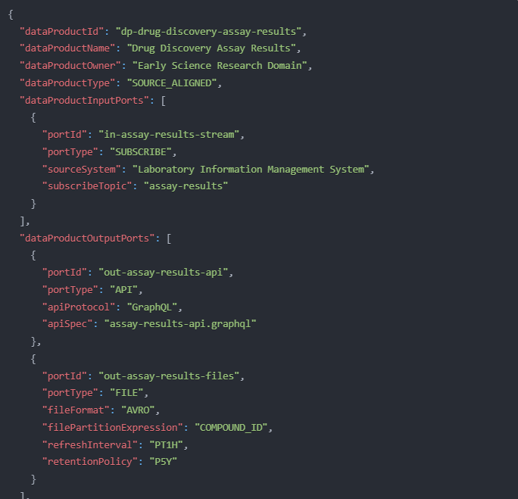
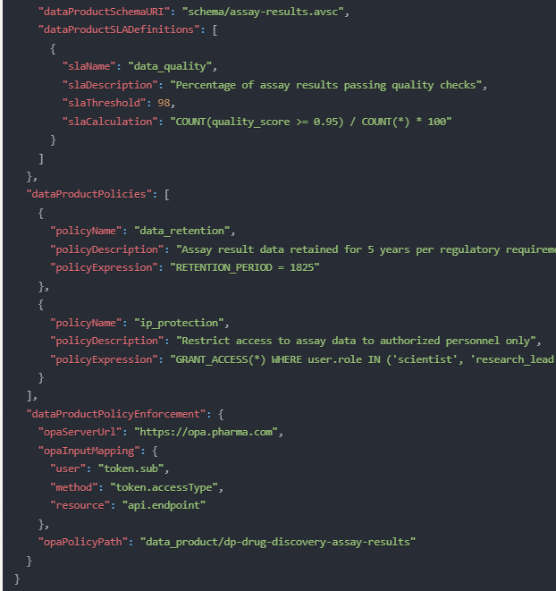

Slide 21
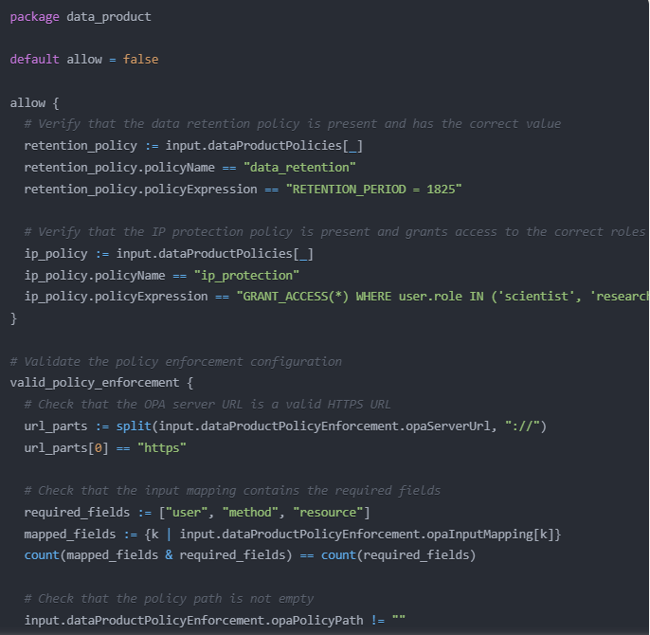
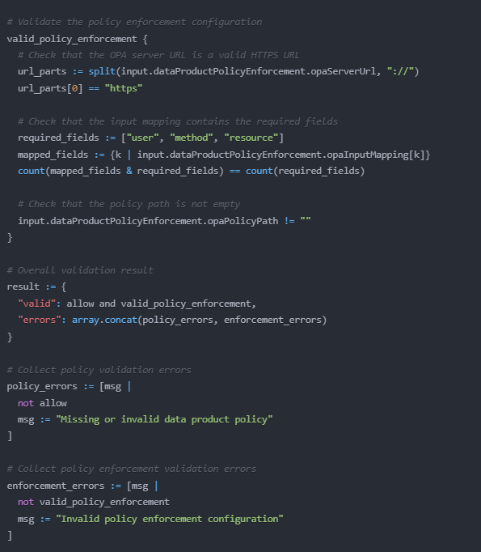

Slide 22
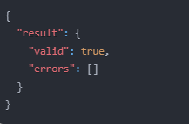
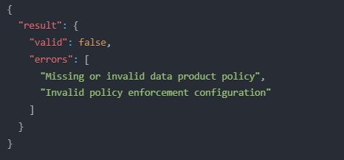

Slide 23
Use Case 2: Validating the Security Policies in Data Products at Consumption
Objective: Data engineers can ensure the correct configuration of security policies for output ports in their data product.
Solution: In the data product configuration the data engineer points to a specific rego policy

Slide 24
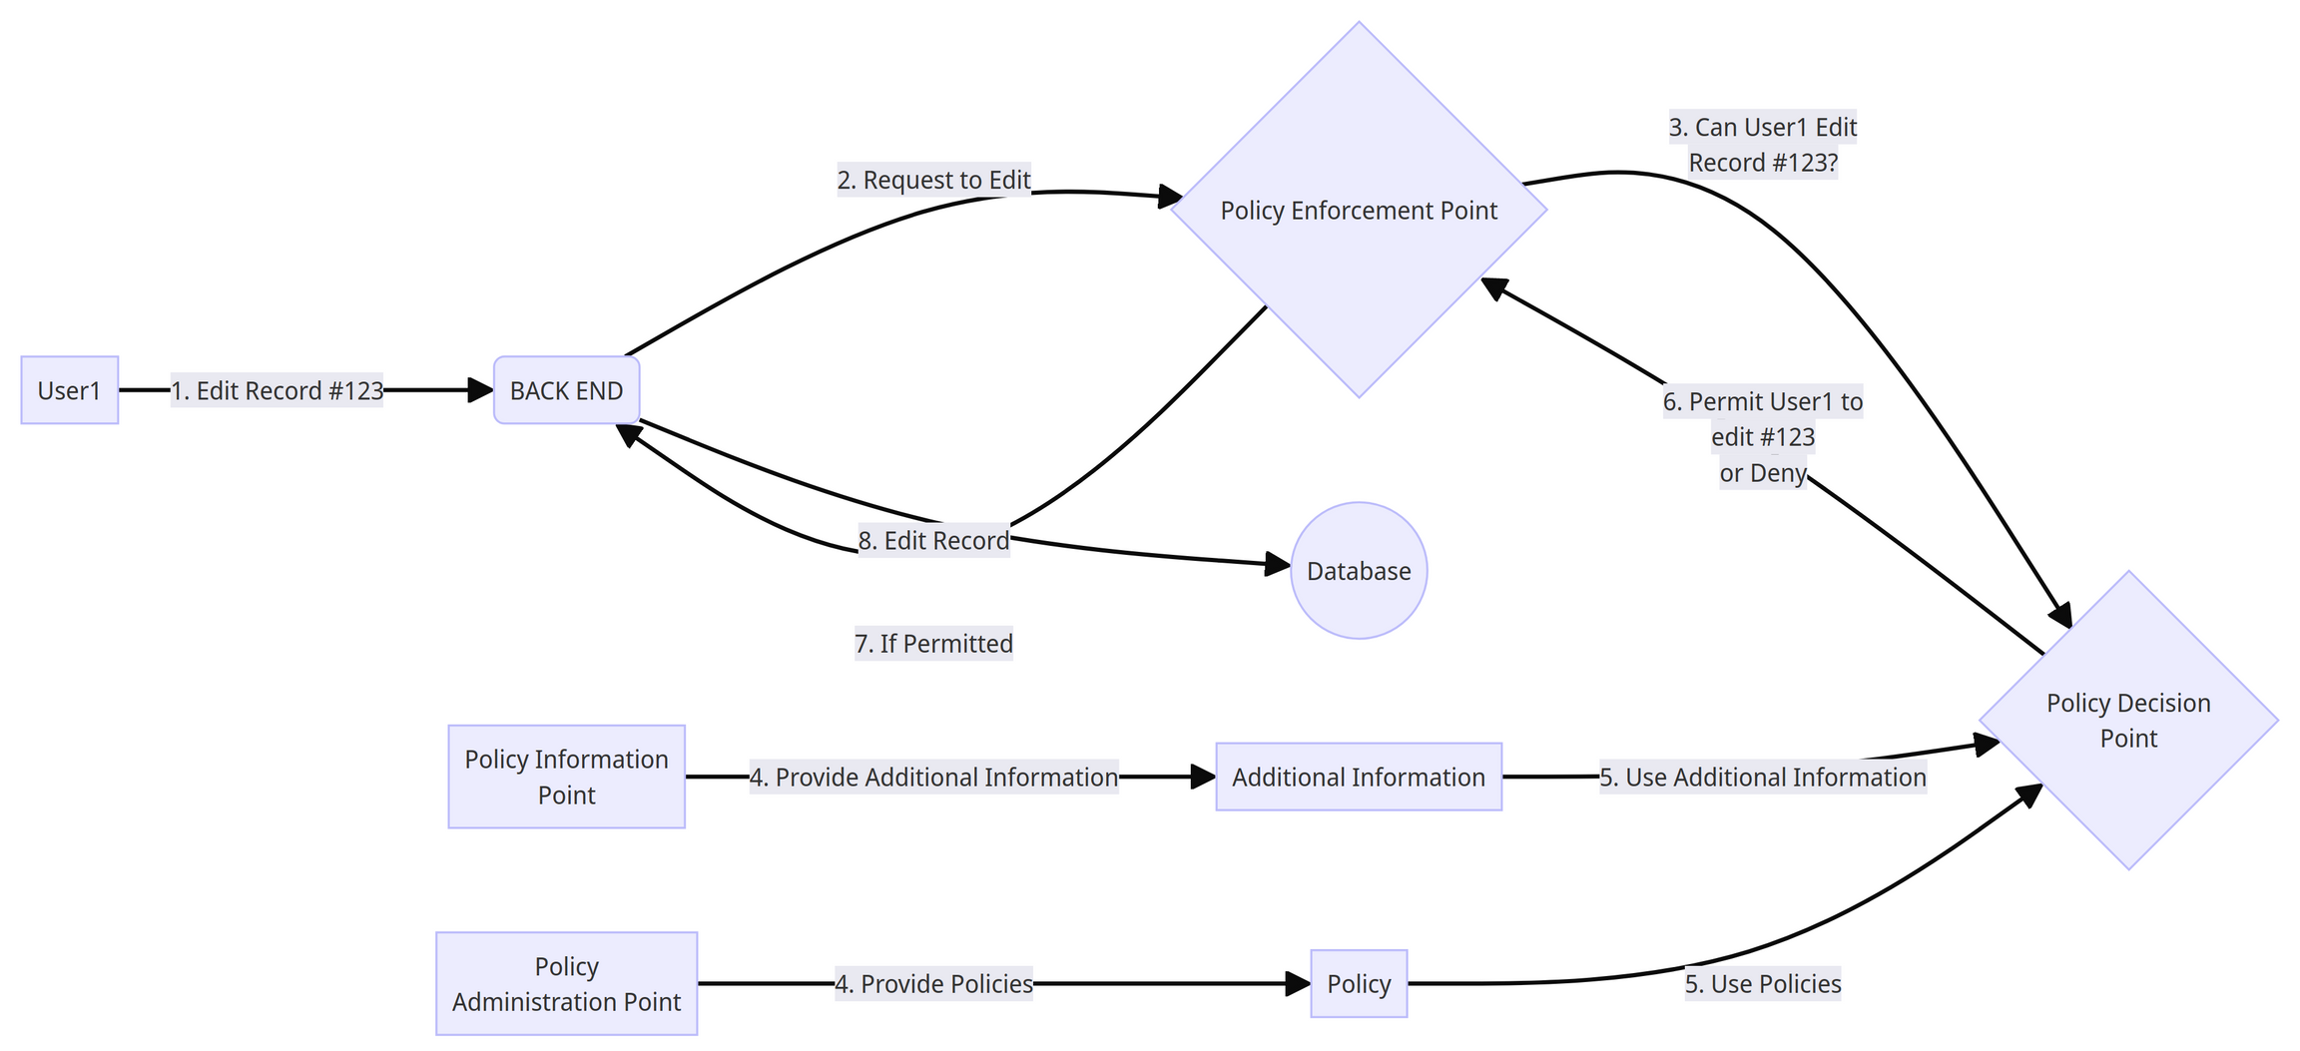
Policy Based Access Control (PBAC)

Slide 25
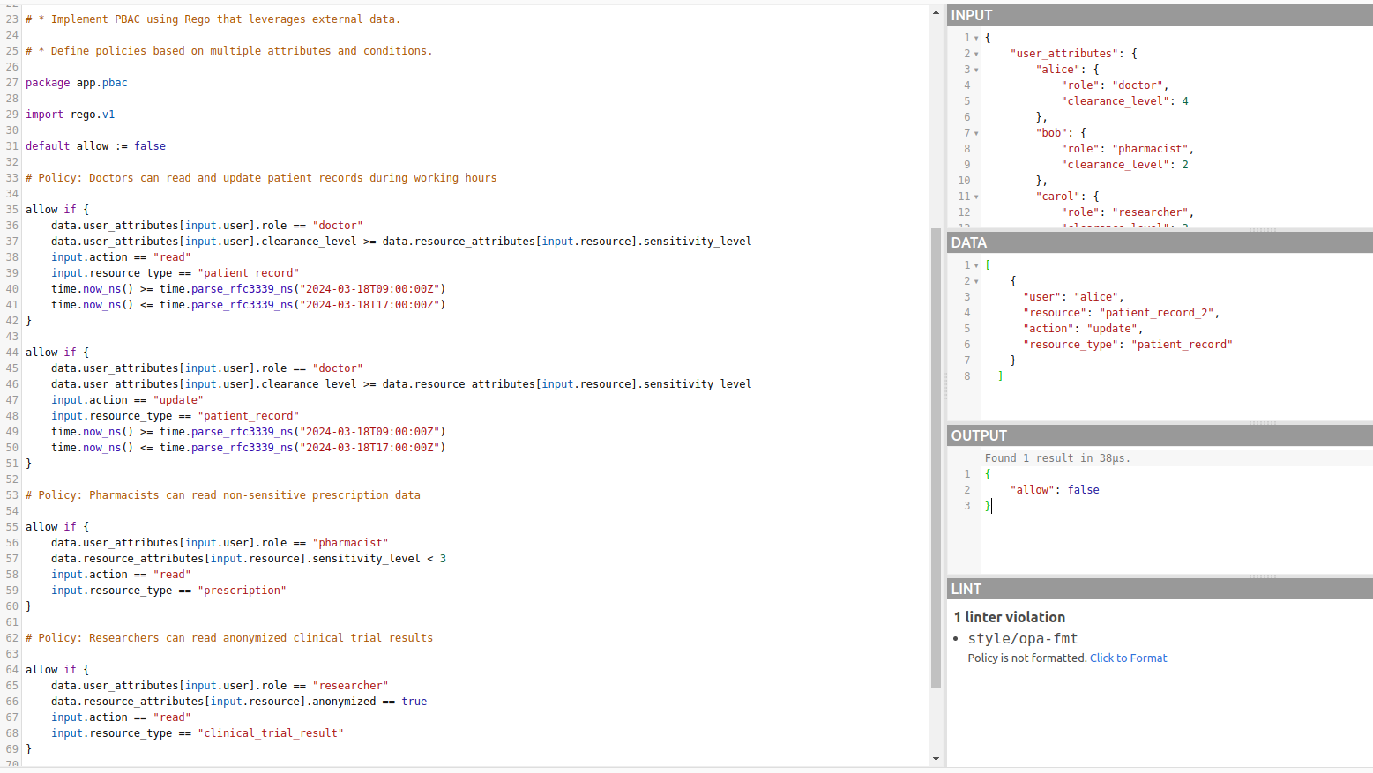

Slide 26
AI Oversight and the Role of PaC

Slide 27
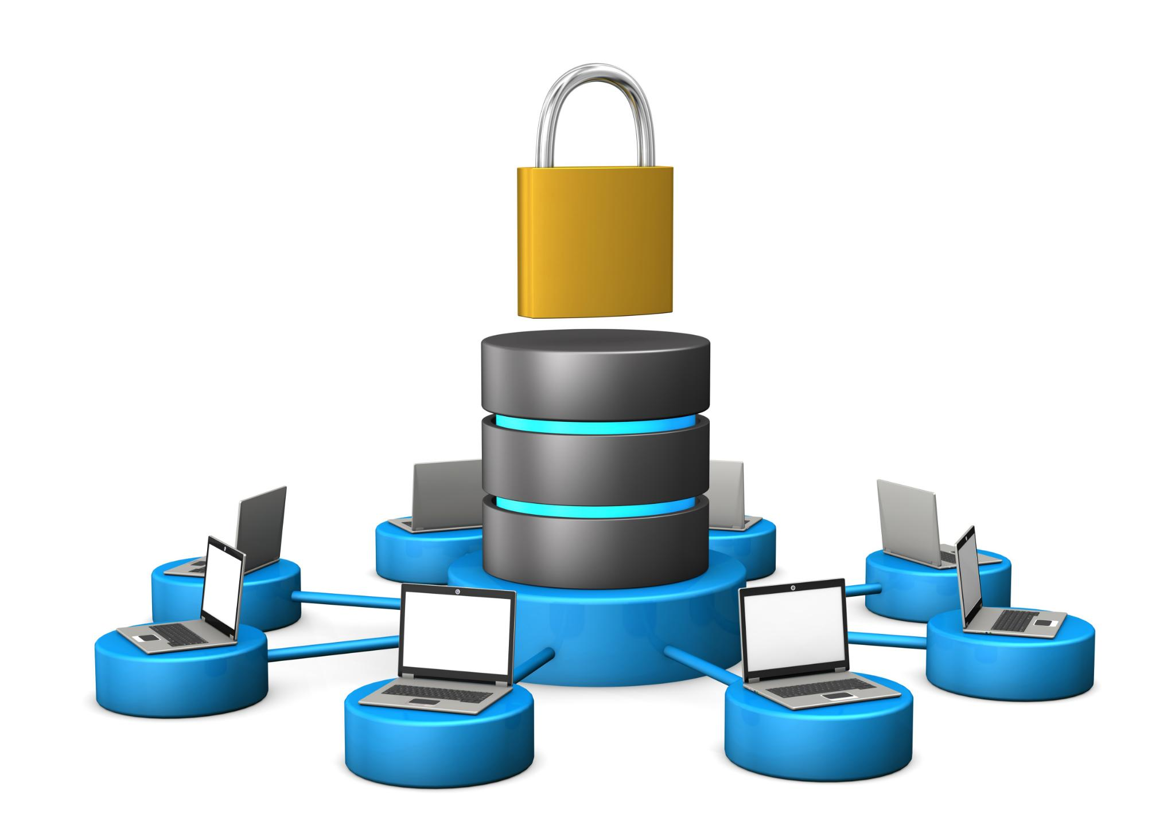
Controlling Access to Vector or Graph Databases
Implement fine-grained access control policies
Enhances security for vector database queries
Restricts unauthorized access
Ensures data integrity and confidentiality
Provides detailed control over user permissions
Facilitates compliance with regulatory requirements
Notes:
Implementing fine-grained access control policies enhances security for vector database queries by restricting unauthorized access, ensuring data integrity and confidentiality, providing detailed control over user permissions, and facilitating compliance with regulatory requirements. Original Content: - Implement fine-grained access control policies for vector database queries

Slide 28
PRE & Post-Execution Policies and Checks : Policy as Prompt
Develop policies for real-time content moderation
Ensure outputs of LLM are appropriate
Implement guidelines for content review
Automated PII Checks
Ensure responses do not contain personally identifiable information
Enhance data privacy and security
Notes:
Create policies to moderate LLM outputs in real-time, ensuring appropriateness and implementing review guidelines. Original Content: - Develop policies for real-time content moderation of LLM outputs

Slide 29
Fine-tuned Models as Oversight Agents
Implement policies for automated sanitization
Ensure responses are free from inappropriate content
Maintain data privacy and security
Notes:
Implement policies for automated sanitization to ensure responses are free from inappropriate content and maintain data privacy. Also, implement automated fact-checking to verify the accuracy of responses and reduce misinformation. Original Content: - Implement policies for automated sanitization and fact-checking of responses

Slide 30

Examples of PaC: In Action: https://play.openpolicyagent.org/
Policy as Code Repo
git clone https://github.com/ShawnKyzer/policy-as-code.git

Slide 31




Q&A and Contact Information

